Slide 1
TIER-Plus: providing evidence to support HIV service prioritization decisions
Prioritization under pressure
Alexandra de Nooy, Amsterdam UMC
16 September 2026

Slide 2
2
WHAT IS TIER-PLUS?
A “what-if” tool for HIV service prioritization and programme decisions
INPUTS
country epidemiology and
intervention coverage
It can be used to consider: what if Malawi did more of this and less of that?
SCENARIOS
change the
intervention mix
OUTPUTS
impact and cost over
one year
It compares choices side by side. It does not make the decision.
2
Notes:
TIER-Plus is a what-if tool. You give it a country's current situation, you change the mix of interventions, and it estimates the consequences: infections avoided, cost, and who's reached. It lets you put options side by side. It does NOT make the decision for you.

Slide 3
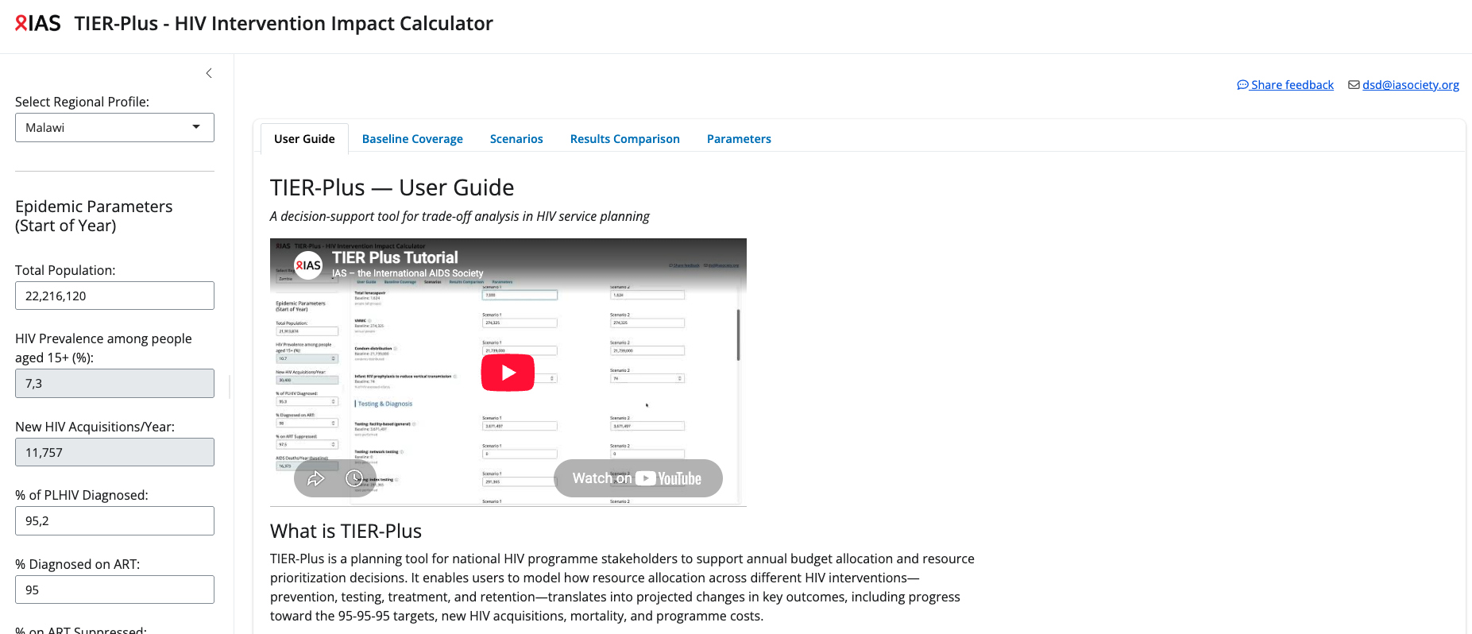
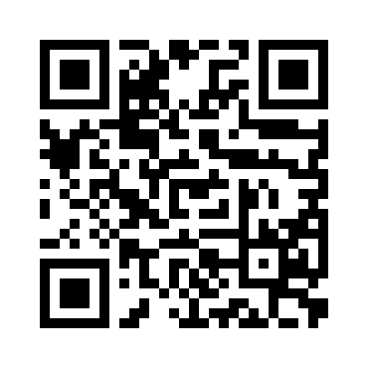
2
WHAT IS TIER-PLUS?
2
Notes:
TIER-Plus is a what-if tool. You give it a country's current situation, you change the mix of interventions, and it estimates the consequences: infections avoided, cost, and who's reached. It lets you put options side by side. It does NOT make the decision for you.

Slide 4
2
Back to our decisions
Not all prevention options can be prioritized at 100% coverage – how do we choose?
Oral PrEP
protect / expand the existing programme
Lenacapavir
introduce long-acting injectable PrEP
You told us what you'd want to know first:
acquisitions averted
costs & value for money
numbers & populations reached
coverage & unmet need
acceptability & equity
VMMC
protect / expand circumcision
Condoms
protect condom programming
3
Notes:
Recap the choice the audience just voted on. You were asked to prioritise across these four — and you told us what you'd want to know before deciding. Let me show you how much of that a tool like TIER-Plus can actually put in front of you, using Malawi's real starting numbers.

Slide 5
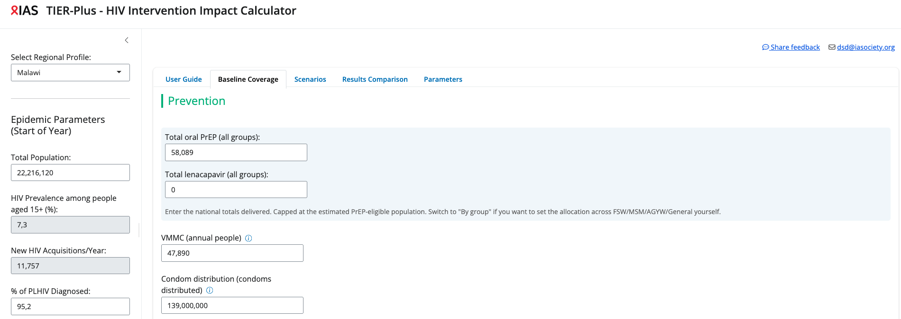
3
Prevention baseline
Malawi’s baseline prevention coverage
4
Notes:
This is where Malawi actually is — current coverage of each approach, and the gaps.

Slide 6
4
WHAT IF WE PRIORITISE DIFFERENTLY?
What if we changed our coverage of prevention services
1
Introduce lenacapavir
Expand coverage of lenacapavir to 400,000 people
6

Slide 7
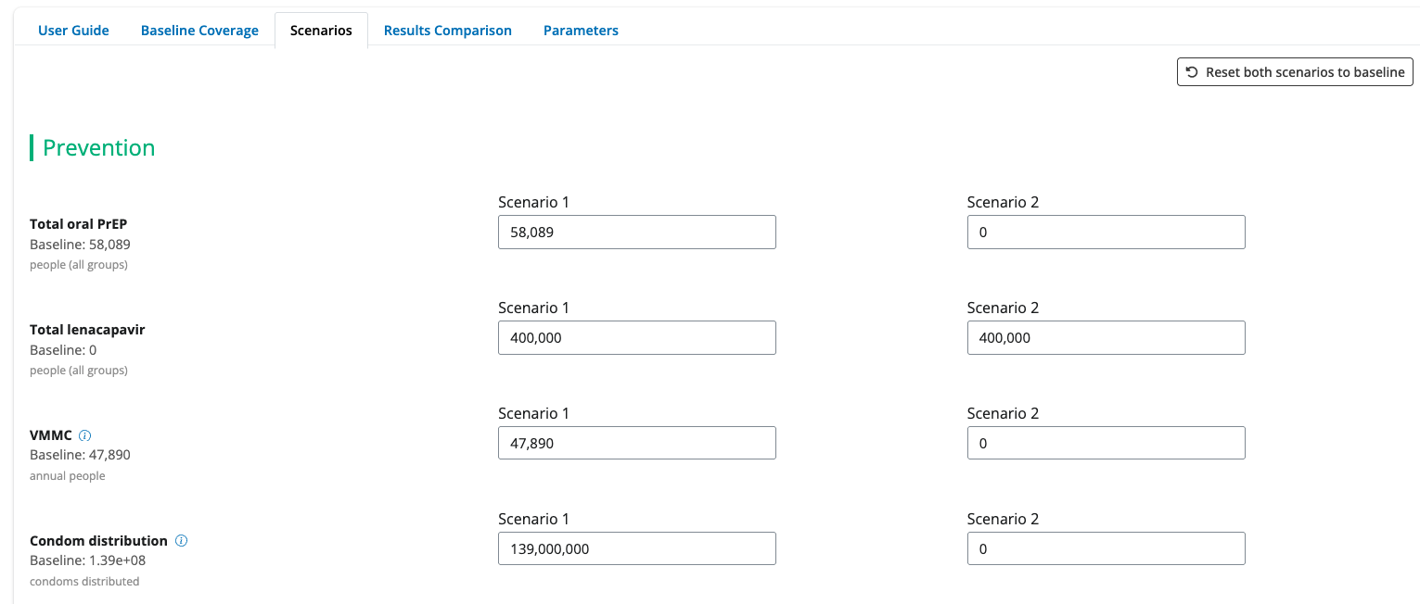
4
WHAT IF WE PRIORITISE DIFFERENTLY?
Building a scenario is just changing the numbers

Slide 8
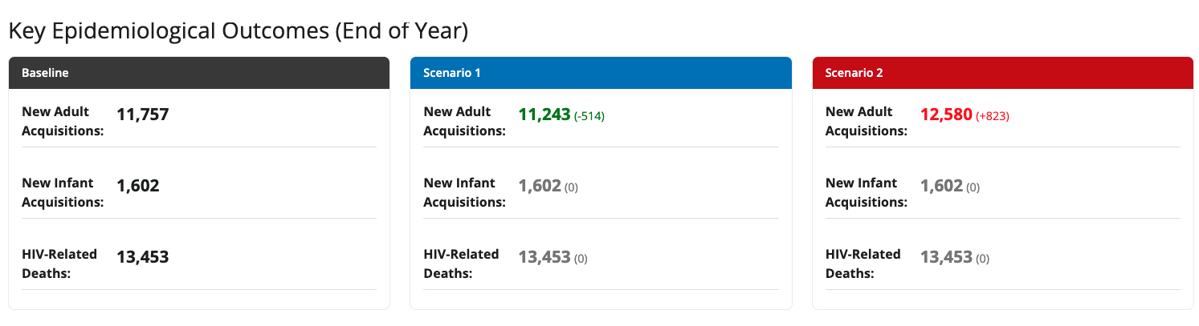
4
WHAT IF WE PRIORITISE DIFFERENTLY?
Trade-offs between scenarios – health outcomes
Introducing lenacapavir at this level averted 514 new adult HIV acquisitions (-4.4%)
7
Notes:
Note: the one-year time-frame limits the onwards effect of reduced infections visible in the tool – hence why some outcomes in the tool appear unaffected

Slide 9
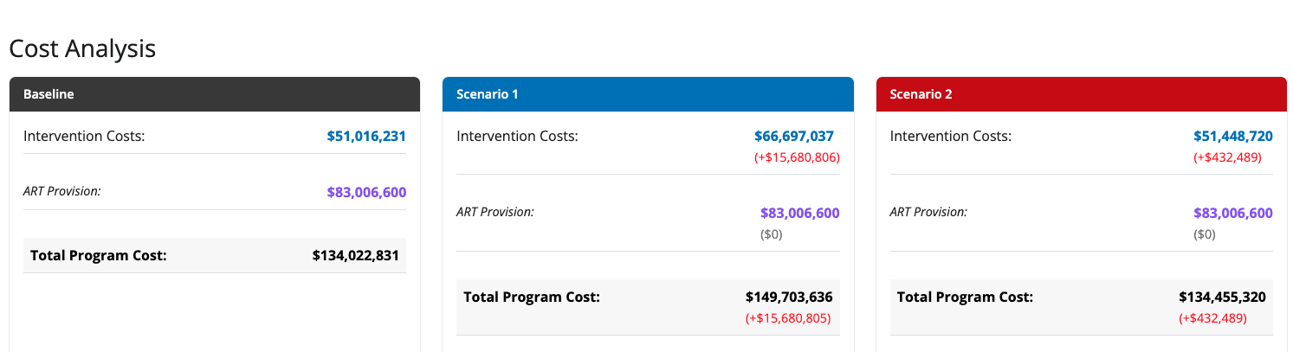
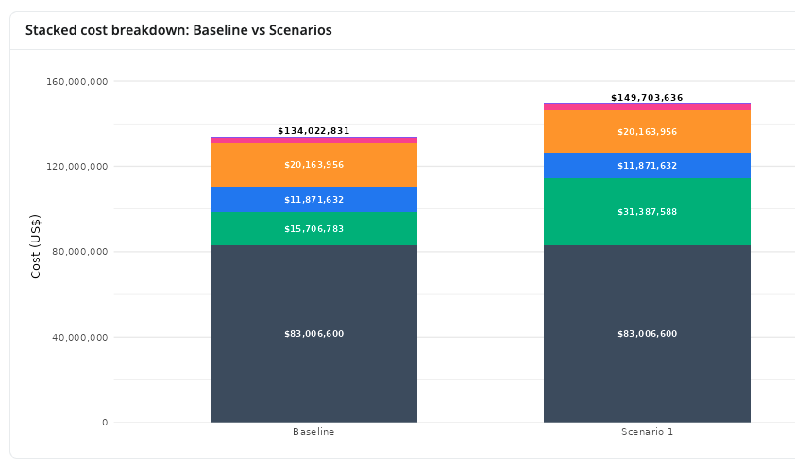
4
WHAT IF WE PRIORITISE DIFFERENTLY?
Trade-offs between scenarios – cost
… but at a potentially infeasible cost
7

Slide 10
4
WHAT IF WE PRIORITISE DIFFERENTLY?
Trade-offs between scenarios – cost
If we do not have sufficient budget, the addition of this much lenacapavir may need come at the expense of other prevention options
… but at a potentially infeasible cost
7

Slide 11
4
WHAT IF WE PRIORITISE DIFFERENTLY?
What if we changed our coverage of prevention services
1
2
Introduce lenacapavir
Maintain overall number of people on PrEP by switching half of those on oral PrEP to lenacapavir
Introduce lenacapvir and reduce other prevention
Decrease oral PrEP, condoms and VMMC until costs are the same as baseline
6

Slide 12
4
WHAT IF WE PRIORITISE DIFFERENTLY?
Adding Lenacapavir and reducing other prevention options

Slide 13
4
WHAT IF WE PRIORITISE DIFFERENTLY?
Trade-offs between scenarios – cost
We now have a much smaller budget increase and total costs are similar between baseline and Scenario 2
7

Slide 14
4
WHAT IF WE PRIORITISE DIFFERENTLY?
Trade-offs between scenarios – health outcomes
But health outcomes have worsened
7
Notes:
Note: the one-year time-frame limits the onwards effect of reduced infections visible in the tool – hence why some outcomes in the tool appear unaffected

Slide 15
4
WHAT IF WE PRIORITISE DIFFERENTLY?
Comparing the trade-offs
Outcomes (relative to baseline) | Scen. A + lenacapavir | Scen B + lenacapavir – oral PrEP – condoms - VMMC
Change in infections | -514 | +823
Change in budget ($) | +15,680,805 | +432,489
TIER-Plus does not tell us what the correct answer is. We could have looked at many combinations of prevention options at different coverage levels.
But, it DOES show the trade-offs between scenarios, letting stakeholders use this information to transparently make decisions or to redesign investment plans.
8
Notes:
"So let's put the two scenarios side by side. In the first, we simply add lenacapavir for 400,000 people — and we prevent 514 new HIV infections. That's real impact. But it costs almost sixteen million dollars more than today, which for many programmes just isn't affordable. So in the second, we asked: what if we keep the budget flat, and pay for lenacapavir by trimming oral PrEP, condoms and VMMC? The budget barely moves — under half a million dollars more. But look at the infections: instead of falling, they rise, by more than 800. Paying for the new tool by cutting the ones already working left more people getting HIV, not fewer. Now — I want to be clear about what this is and isn't. TIER-Plus is not telling you either of these is the right answer; these are just two of hundreds of combinations we could have modelled. What it's doing is making the trade-off visible — more impact but a higher cost on one side, budget-neutral but worse health on the other — so that everyone at the table can see exactly what's being weighed, and redesign the plan from there."

Slide 16
5
WHAT TIER-PLUS CAN TELL YOU
What information can Tier-Plus provide?
TIER-Plus can help with
✓
Highlight current coverage & unmet need within interventions (in countries with validated data)
✓
Show trade-offs in health outcomes between scenarios e.g acquisitions averted or gained for prevention interventions
✓
Indicate likely cost differences between scenarios
✓
Contribute towards discussion and decisions surrounding the value for money of interventions
9
Notes:
You told us at the start what you wanted to know. Here's what TIER-Plus can actually put in front of you. It can show current coverage and where the gaps are — the unmet need — in countries where the data has been validated, like Malawi. It can show the health trade-offs between scenarios: infections averted, or, as we just saw, infections gained. It can indicate the likely cost differences. And it can feed a real conversation about value for money. So several of the things you asked for, it can genuinely help with."

Slide 17
5
WHAT TIER-PLUS CAN’T TELL YOU
What information can Tier-Plus not provide?
✗
One-year horizon — under-counts long-run benefit — particularly relevant for prevention
✗
Constrained interventions — cannot model every intervention or element of implementation
✗
Not the whole picture — misses acceptability, lived experience and access barriers
✗
Not equity or rights — can’t easily weigh who is left behind
✗
Not why people choose — can't tell you why someone prefers one option over another
10
Notes:
"But — and this matters just as much — here's what it can't. It works over a one-year horizon, so it under-counts the benefits that build up over time, and that's especially true for prevention. It can't model every intervention, or every detail of how a programme is really delivered. And it can't see the things that don't fit in a spreadsheet: whether people find an option acceptable, the barriers they face getting to it, whether it's fair — who gets left behind — or why someone chooses one option over another. So this is one input. It is not the decision."

Slide 18
6
HOW COMMUNITIES CAN USE IT
Communities can use TIER to:
Challenge assumptions and ask sharper questions about proposed investments
Compare alternative scenarios and advocate for their consideration
Have discussions with other stakeholders using the same tool, with the same data and seeing the same outputs.
11
Notes:
"So where does that leave you, in this room? Three things. Use it to challenge assumptions and ask sharper questions about what's being proposed. Use it to build your own alternative scenarios — and push for them to be taken seriously. And use it to sit down with ministries, funders and researchers looking at the same tool, the same data, the same outputs, so the conversation starts on equal footing. The real shift is that communities help decide which scenarios get modelled in the first place — not just react to the options handed down."

Slide 19
THE KEY MESSAGE
TIER-Plus can’t tell Malawi (or any other country) what to prioritise. It makes the consequences of each choice visible — so decisions are transparent, evidence-based, and open to challenge.
12
Notes:
"So, the one thing I'd like you to take away. TIER-Plus can't tell Malawi — or any country — what to prioritise. What it does is make the consequences of each choice visible, so decisions can be transparent, evidence-based, and open to challenge. But you've just heard everything it can't see — acceptability, equity, lived experience, the reasons people choose. Those are exactly the pieces the numbers can't give us. And that's where [Clarence] comes in, to talk about the evidence and the perspectives that modelling alone can never provide. [Clarence], over to you."

